Slide 1
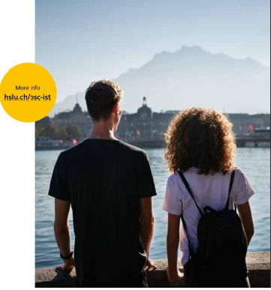
The Lucerne University of Applied Sciences and Arts (HSLU) is one the largest educational institutions
in Switzerland with 8,300 students at six Schools. HSLU is globally acknowledged for its expertise in Tourism and Sustainability.
United National World Tourism Organization (UNWTO) is launching together with HSLU a 4-year bachelor in International Sustainable Tourism.
Application deadline:
30th of March 2024

Slide 2
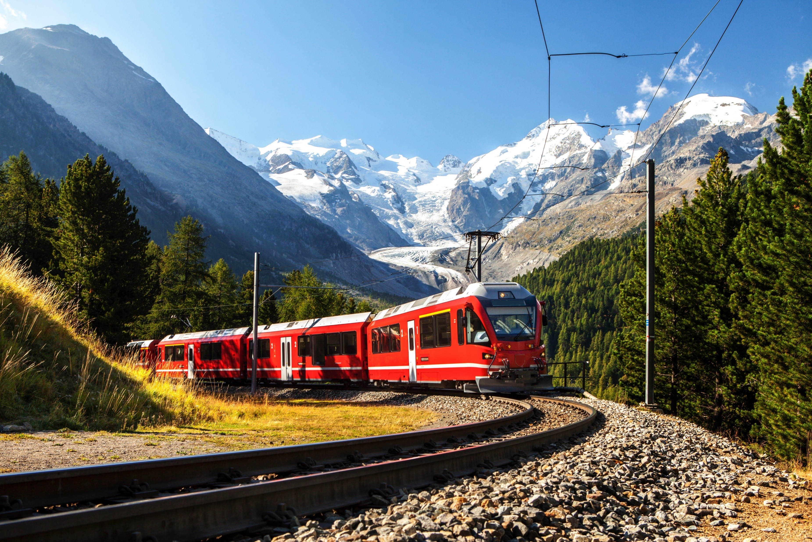
The programme starts with a 1-year internship in Tourism. Then students go to Madrid
for the second year and finally go to Lucerne to complete their degree.
Detailed information about the Programme :
https://www.hslu.ch/en/lucerne-school-of-business/degree-programmes/bachelor/international-sustainable-tourism/
Information about how to apply to the programme:
https://www.hslu.ch/en/lucerne-school-of-business/degree-programmes/bachelor/international-sustainable-tourism/admission/

